Slide 1
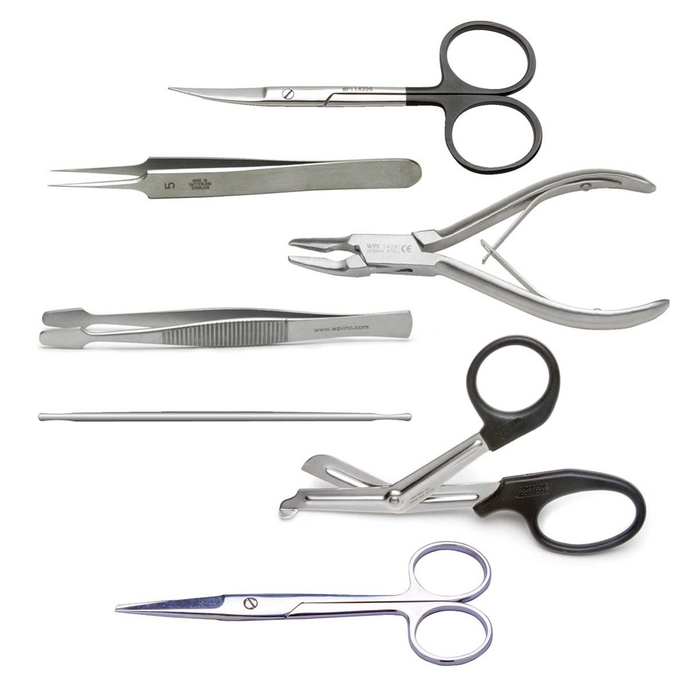
Surgical Instruments

